Slide 1
GRADUATE SCHOOL OF
NATURAL AND APPLIED SCIENCES

Slide 2
GSIS
GSIS (Graduate Student Information System) is an online registration system that helps students to register the courses, bears information on the weekly schedule, the grades, and qualifiying exam applications for PhD students.

Slide 3
GSIS – How do I login?
Usernames and passwords for logging into gsis.yildiz.edu.tr are delivered to the departments within the week following your registration to our Institute.
It is important that you do not lose your account details since you will need them until your graduation. However, in case of a loss, you must submit a petition to the IT Office (Bilgi İşlem Merkezi) to ask for a new one.

Slide 4
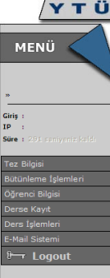
GSIS – Left Menu
Weekly Schedule
Transcript
Course registration processes
Information on the courses:
Quotas
Course Section
Room of the course, etc.

Slide 5
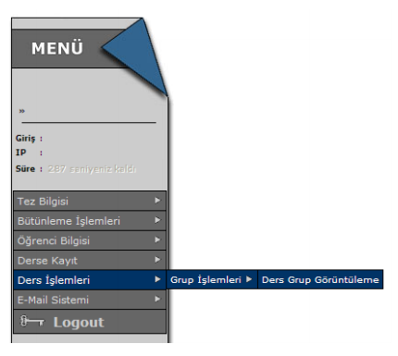
GSIS – COURSE PROCESSES
(DERS İŞLEMLERİ) MENU
In order to find the code and the appropriate section of the course, you may use this menu. You may also refer to the schedule announced on the website of your department.
Ders İşlemleri Grup İşlemleri Ders Grup Görüntüleme
‘Course Processes Section Processes Show Course Section’

Slide 6

When you click on Show Course Section (Ders Grup Görüntüleme), you will see the menu below which asks you to choose the department and the course. You must first choose the department and click on ‘Select’ (Seçiniz) in order to be able to see the list of the courses.

Slide 7
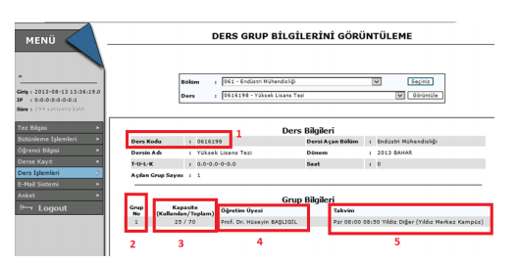
When you select the course, the screen above will appear.
The information given in boxes are:
1. Course Code
2. Section Number
3. The overall quota and registered students per section
4. The lecturer
5. Time and Campus of the course
You will use this information to register the courses.

Slide 8
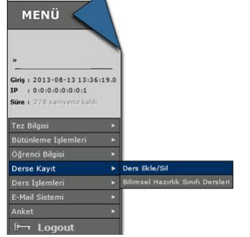
Course Registration
Once you know the code and the section, click on the Course Registration (Derse Kayıt) > Add/Drop Course (Ders Ekle/Sil) button on the left menu.

Slide 9
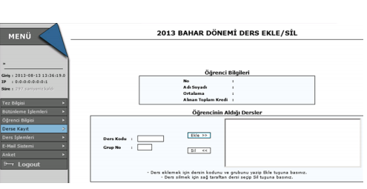
Fill in the Course Code (Ders Kodu) and Section (Grup No) boxes and click on the Add (Ekle) button.

Slide 10
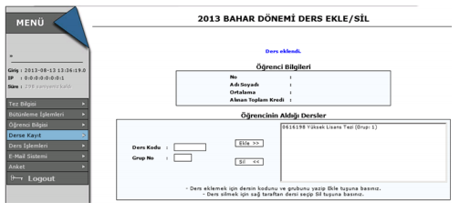
The secreen below will appear with the information that ‘The course has been added.’ (Ders eklendi)
To drop a course, you must select the course and click on the Drop (Sil) button.

Slide 11
How to Transfer Credits
If you have taken courses as a special student at YTU or at other academic institutions, you can transfer up to 4 courses.
Within the three months following your registration, you must submit a petition to your department. In the petition, you should clearly state the courses you want to transfer. Make sure you attach the transcript and the syllabus of the course(s) to the petition.

Slide 12
Courses
The course load that you must complete is
    21 credits, a seminar (non-credit) and a thesis course for master’s degree,
    24 credits, qualifiying exam, thesis proposal and thesis course for doctorate’s degree.
A master’s student may select up to three undergraduate courses unless they have taken them during their undergraduate degree.
In an English program, all the courses must be taken in English.

Slide 13
Advisor Appointment
You must submit the Thesis Advisor Appointment Form, which is available on the Documents section of our website, to your department.
The appointment must be done by the end of the second term for master’s students and by the end of the third term for PhD students.
For the students in the preparatory year as well as Turkiye Scholarship students who study Turkish for one year, the advisor appointment process starts after the prep year.

Slide 14
Course Evaluation & Grades
Percentage Grade Out of 4
90-100 AA 4.00
80-89 BA 3.50
70-79 BB 3.00
60-69 CB 2.50
50-59 CC 2.00
40-49 DC 1.50
30-39 DD 1.00
20-29 FD 0.50
0-19 FF 0.00
Not Attended* F0 0.00
*70 % of attendance is obligatory.
Minimum passing grade is 2.50 (CB) for MSc and 3.00 (BB) for PhD students.
Minimum GPA for graduation is 2.50 for MSc and 3.00 for PhD students.

Slide 15
THESIS
In a Turkish program, the thesis could be written in English if it is accepted by the advisor and the head of department.
In an English program, the theses are obligatorily written in English.

Slide 16
Follow the announcements on our website:
www.fbe.yildiz.edu.tr/en
Follow us on Twitter:
@YTUFBE
and Facebook
@YTU Fen Bilimleri Enstitüsü
Contact us via:
fbe-grad@yildiz.edu.tr
muge.gedik@yahoo.com

